Slide 1


Batch 2- churn Modelling On Telecom Data
By Divya Bagade

Slide 2
1. About Telecom Churn Prediction | 6. ML Model Building
2. Our Mission And Vision | 7. Model Evaluation And Validation
3. Our Goals | 8. Hyperparameter Tunning
4. Key Challenges | 9. SVM & Confusion Matrix
5. Data Cleaning &Preprocessing | 10. Conclusion
Agenda

Slide 3


About Telecom Churn Prediction
Telecom churn prediction is a critical task for companies to identify customers at risk of leaving and take proactive measures to retain them. This presentation will cover the process of building a predictive model to anticipate and prevent customer churn.

Slide 4


Our Mission and Vision
Mission
Vision
To develop an accurate and reliable churn prediction model that empowers our telecom clients to make data-driven decisions and improve customer retention.
To be the leading provider of predictive analytics solutions that transform the telecom industry and redefine the customer experience.

Slide 5
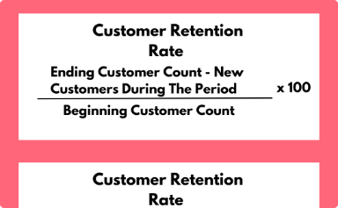



Our Goals
Increase Retention Rates
Enhance Customer Satisfaction
Drive Business Growth
Optimize Business Performance
Reduce customer churn by accurately identifying high-risk accounts and implementing effective retention strategies.
Leverage predictive insights to proactively address customer needs and improve overall satisfaction.
Provide telecom clients with a competitive advantage through our advanced churn prediction capabilities.
Advanced analytics and machine learning are used in telecom churn prediction to identify customer churn factors, enabling proactive retention strategies to reduce attrition and boost profitability.

Slide 6


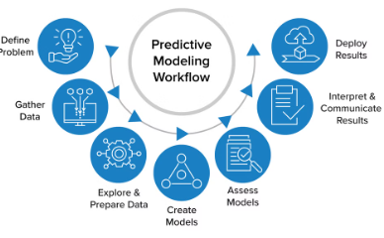
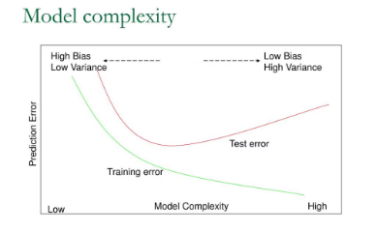
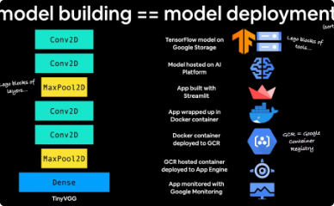
key challenges
Data Quality and Completeness
Feature Engineering
Model Complexity
Deployment and Scalability
Identifying the right set of customer attributes and behavioral signals that influence churn is crucial. This requires deep domain expertise and extensive experimentation.
Churn is a complex phenomenon influenced by a variety of factors. Developing a model that can capture these nuances while maintaining interpretability is a delicate balance.
Telecom data can be noisy, incomplete, and distributed across multiple systems. Ensuring high-quality, consistent data is critical for model performance.
The final model must be deployable at scale, with the ability to continuously ingest new data and generate real-time predictions to enable timely interventions.

Slide 7
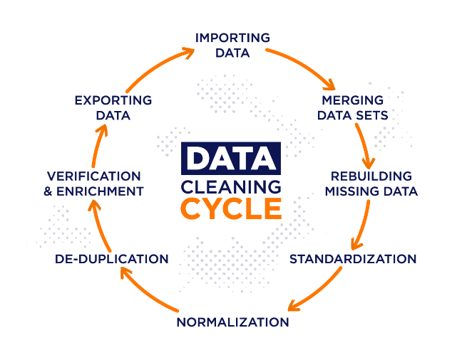
Data Cleaning and Preprocessing
1
Data Exploration
Understand the structure, characteristics, and potential issues in the customer data.
2
Data Cleaning
Address missing values, outliers, and inconsistencies to ensure data integrity.
3
Feature Engineering
Create new, meaningful features from the raw data to enhance the predictive power.

Slide 8
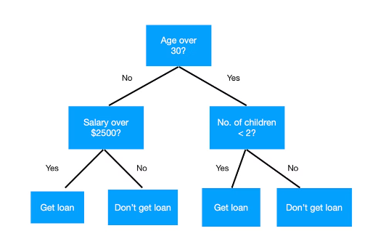
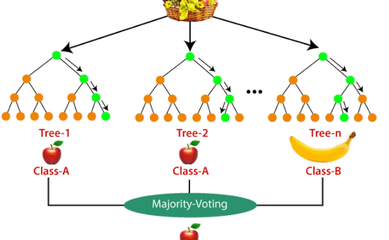
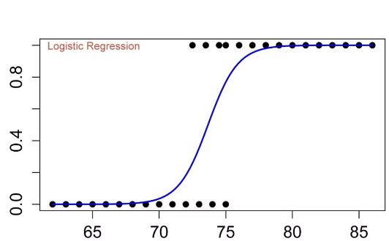
Machine Learning Model Building
Decision Trees
Random Forest
Logistic Regression
Powerful classifiers that can capture non-linear relationships in the data.
Ensemble methods that combine multiple decision trees for improved accuracy.
Widely used for binary classification tasks, such as predicting customer churn.

Slide 9



Decision Tree
Identify Root Node
1
Select the most influential feature
Recursively Split Data
2
Divide data based on feature values
Classify New Instances
3
Assign class labels to unseen data
Decision trees are a powerful machine learning algorithm that can capture complex, non-linear relationships in the data. They work by recursively partitioning the dataset based on the most informative features, creating a tree-like structure of decisions that can be used to make predictions on new, unseen data.

Slide 10
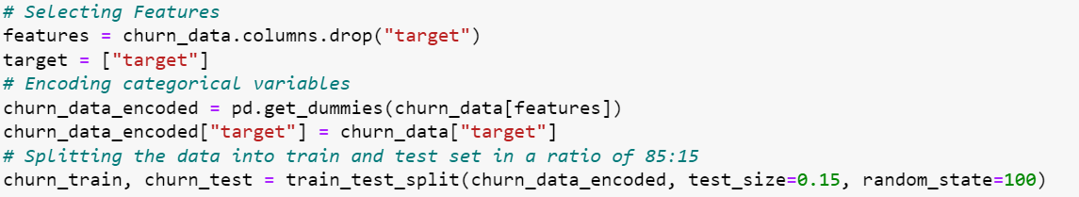
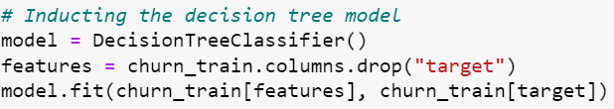
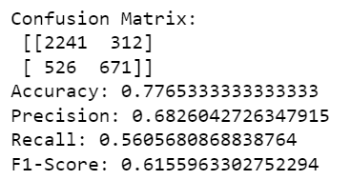
Code Snippet

Slide 11
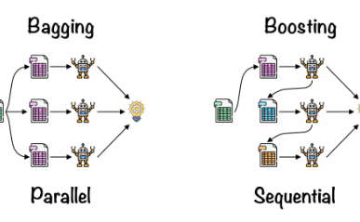
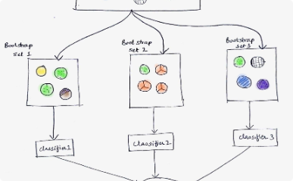
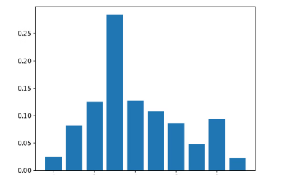
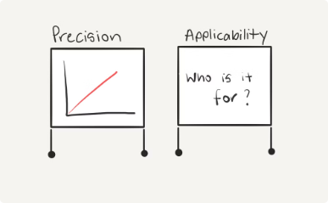
Random Forest
Ensemble Method
Bagging Technique
Feature Importance
Versatile Applicability
Random Forest combines multiple decision trees to improve accuracy and robustness.
The algorithm trains each tree on a random subset of the data, allowing the model to capture different patterns and reduce overfitting.
Random Forest can provide insights into the relative importance of different features, guiding feature engineering and selection.
This algorithm can handle a wide range of data types, including numerical, categorical, and mixed features.

Slide 12
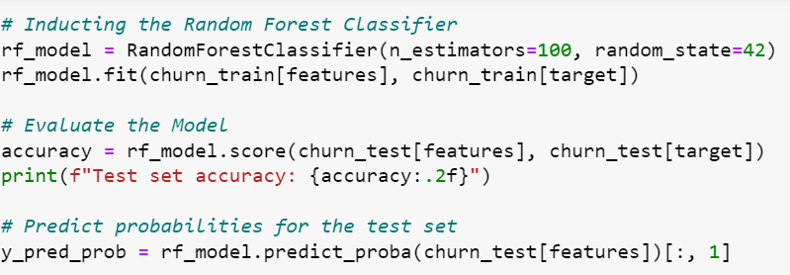
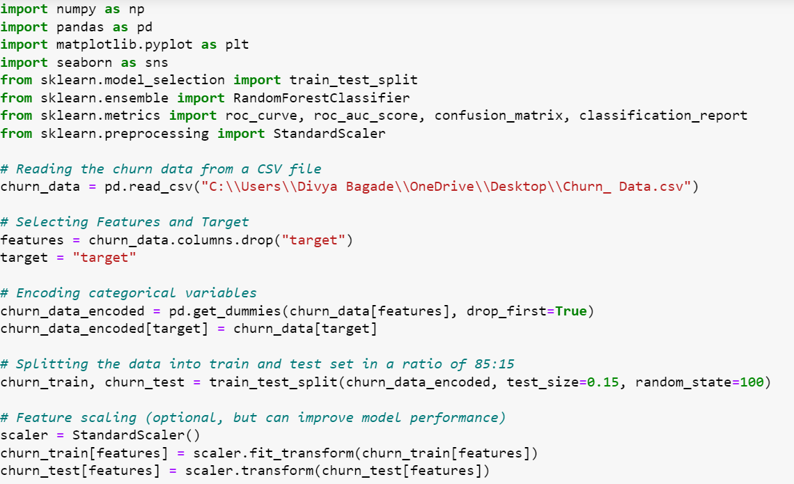
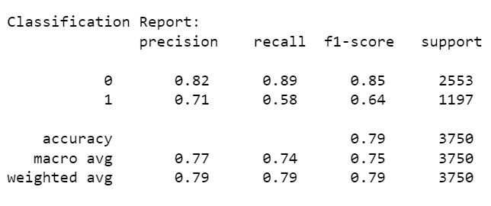
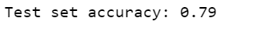
Code Snippet

Slide 13


Logistic Regression
1
Probabilistic Approach
Logistic Regression outputs the probability of an instance belonging to a particular class, rather than a hard classification.
2
Flexibility
The algorithm can handle a variety of data types, including numerical, categorical, and mixed features.
3
Interpretability
Logistic Regression models provide insights into the relative importance of different features, making it easier to understand the driving factors behind the predictions.

Slide 14
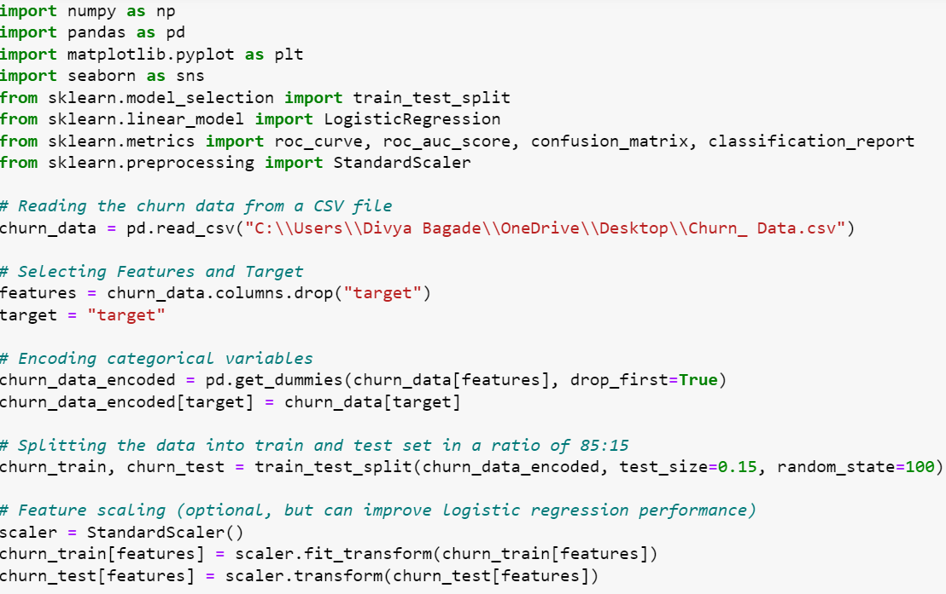
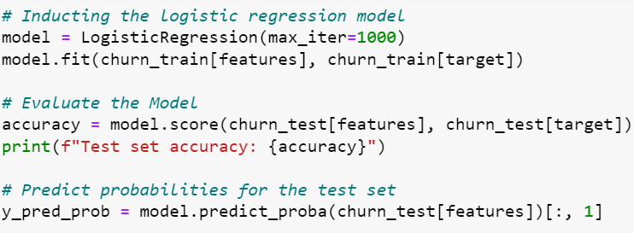
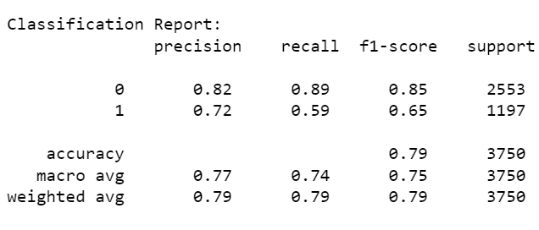
Code Snippet

Slide 15
Parameters | Decision Tree | Logistic Regression | Random Forest
Training Accuracy | 0.77 | 0.79 | 0.79
Testing Accuracy | 0.77 | 0.79 | 0.79
Precision | 0.68 | (0) 0.82 (1) 0.72 | (0) 0.82 (1) 0.71
Recall | 0.56 | (0) 0.89 (1) 0.59 | (0) 0.89 (1) 0.58
Key Difference

Slide 16

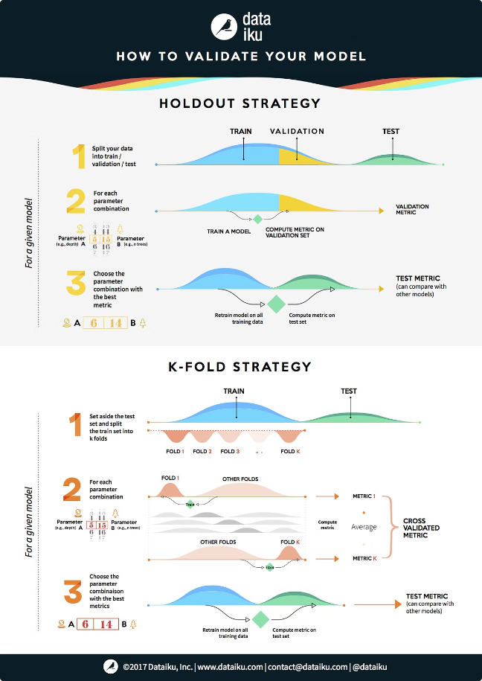



Model Evaluation and Validation
Cross-Validation
Assess model performance on multiple training and testing splits to ensure robustness.
Metrics Evaluation
Measure the model's accuracy, precision, recall, and F1-score to determine its effectiveness.
Holdout Testing
Evaluate the model's generalization capability on an unseen, independent dataset.

Slide 17
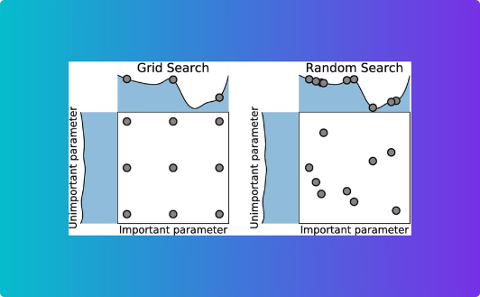
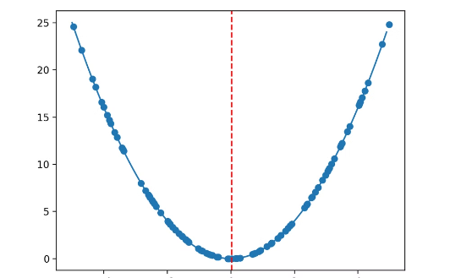
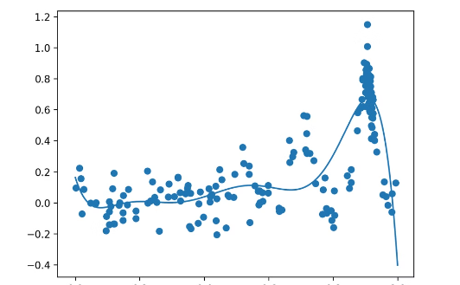
Hyperparameter Tuning
Grid Search
Random Search
Bayesian Optimization
Systematically explore a predefined set of hyperparameters to find the optimal configuration.
Randomly sample hyperparameter values within a specified range to identify the best model.
Use a probabilistic model to intelligently navigate the hyperparameter space and converge on the optimal settings.

Slide 18
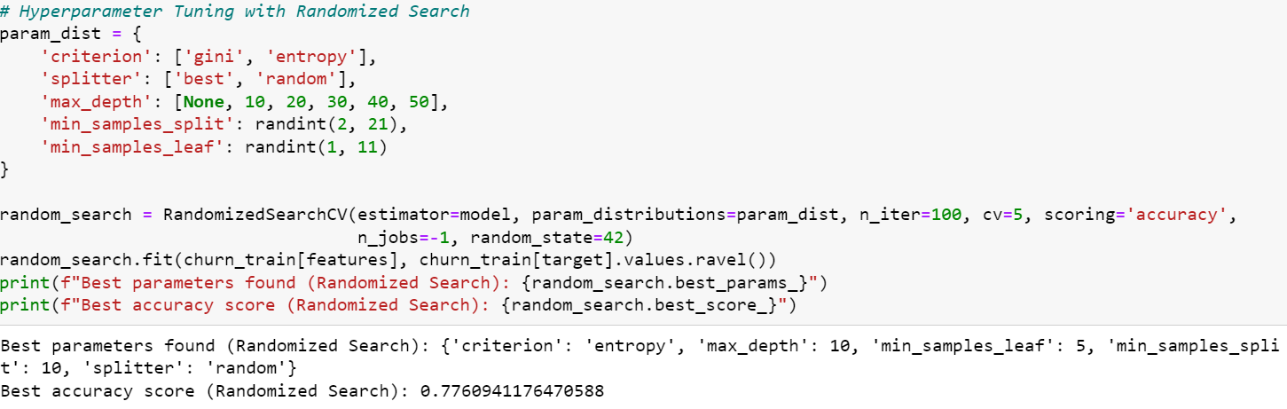
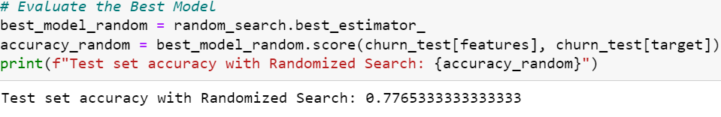
Code Snippet

Slide 19
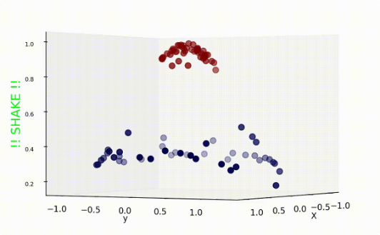
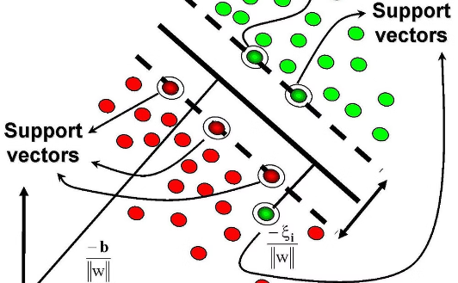
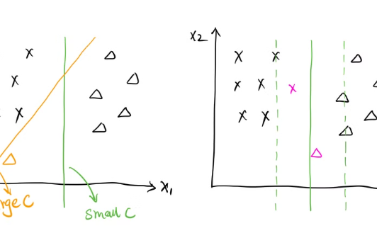
Support Vector Machine
Geometric Approach
Regularization
Kernel Trick
Support Vector Machines (SVMs) use a geometric
approach to find the optimal hyperplane that separates different classes with the maximum margin.
The kernel trick allows SVMs to handle
non-linear decision boundaries by mapping the data to a higher dimensional space where it becomes linearly separable.
Regularization techniques like C-parameter and gamma help SVMs balance model complexity and generalization, preventing overfitting.

Slide 20

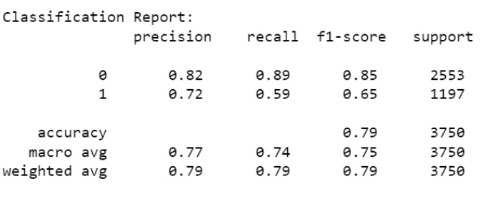
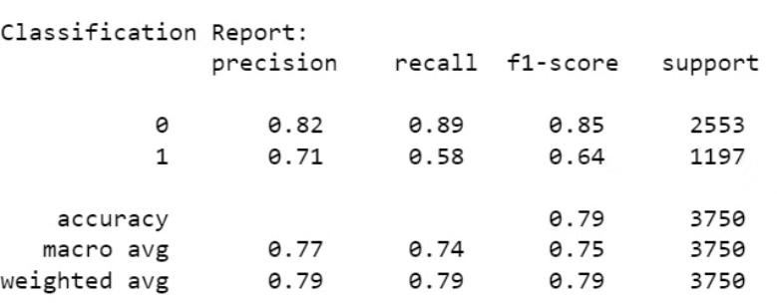

Slide 21
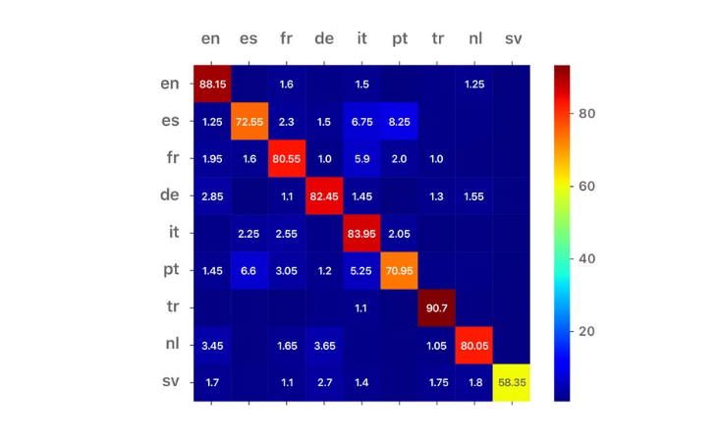
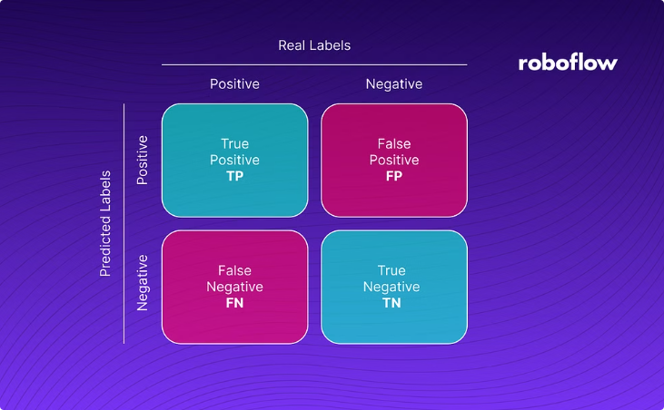

Leveraging the Power of the Confusion Matrix
Insights from Confusion Matrix
A confusion matrix is a visual tool that provides a comprehensive evaluation of the model's predictive performance, including accuracy, precision, recall, and F1-score.
The confusion matrix helps identify areas for improvement, such as false positives or false negatives, to enhance the overall model performance.

Slide 22
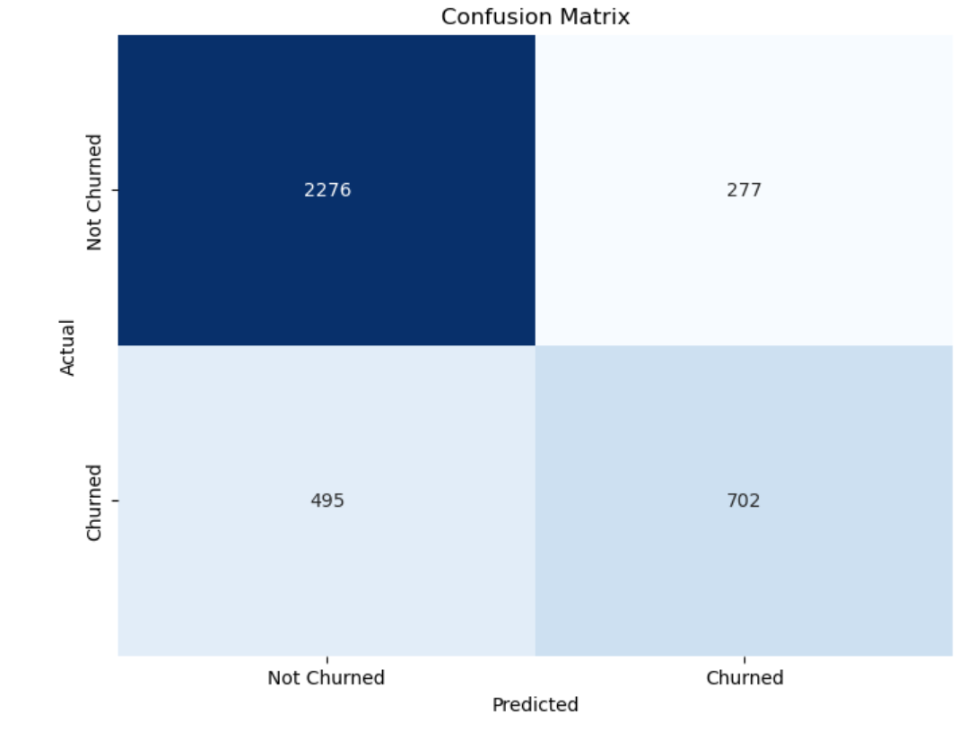
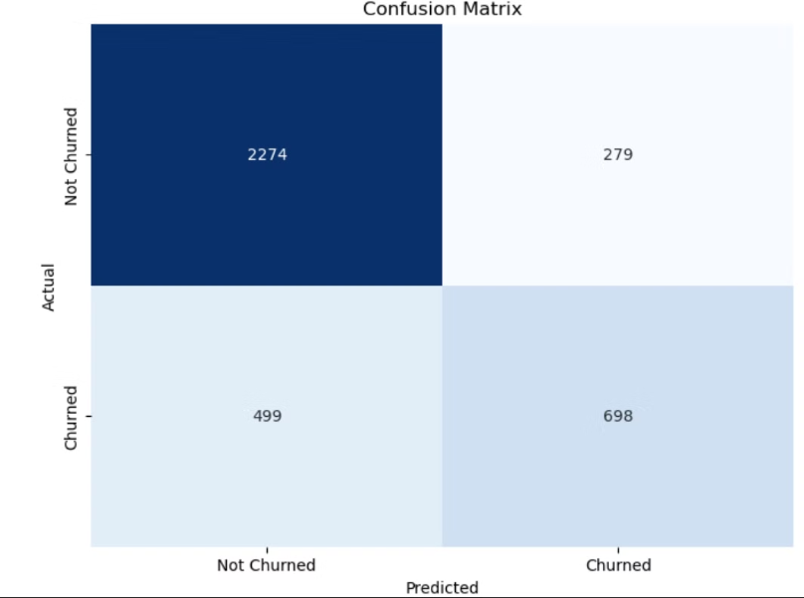
Code snippet

Slide 23


Conclusion and Future Considerations
1
Effective Churn Prediction
The developed model demonstrates a robust and accurate approach to predicting customer churn in the telecom industry.
2
Ongoing Optimization
Continuous monitoring, model updates, and incorporation of new data sources will ensure the sustained accuracy and relevance of the churn prediction solution.
3
Expanding Capabilities
Exploring advanced techniques like deep learning and leveraging external data sources can further enhance the predictive capabilities and uncover deeper insights.

